Slide 1
Build an English-based Representative Tool
自然語言模型(BERT)視覺化工具
40847041S 朱自宇 指導教授：王科植 教授

Slide 2
Table of Contents
BERT
動機發想
實作方法
Before the beginning
The main purpose
How to do
成果展示
反思&展望
客座提問
What I have done
What can be better
What you should do

Slide 3

BERT
Part 1: Before the beginning

Slide 4
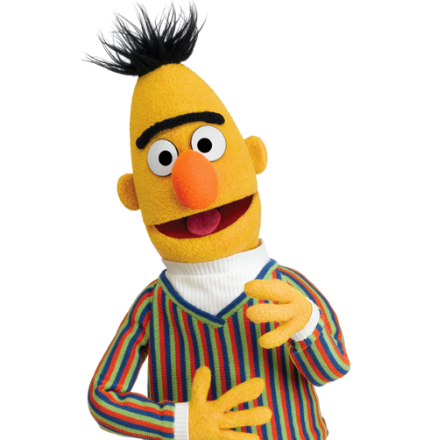

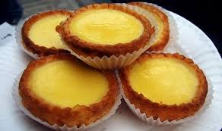
What is BERT ?
Butter Egg Tart
Bert & Ernie in Sesame Street
Bidirectional Encoder Representation from Transformers

Slide 5

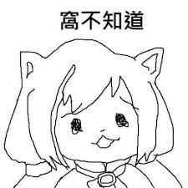
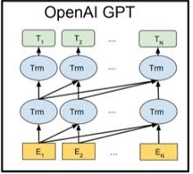
Natural Language Processing
Allowing computers to understand texts and spoken words like we do
Create Language Models and use huge amounts of texts to training
Finally, computers find out the rules of our language

Slide 6
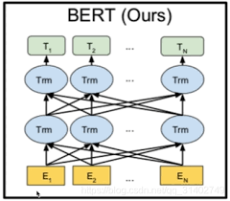
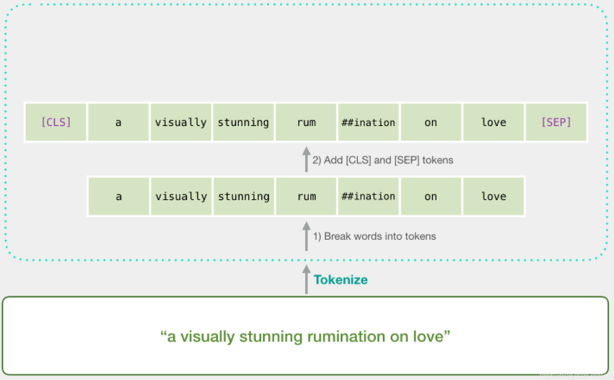
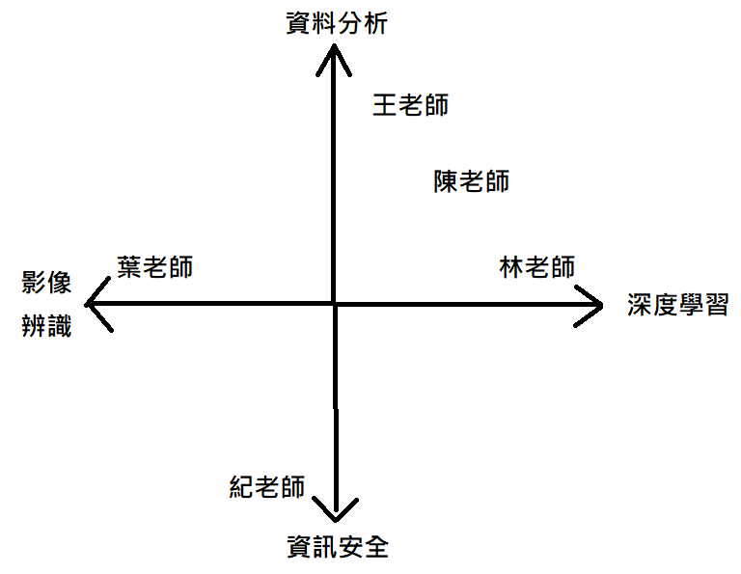
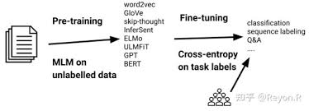
In BERT…
每一個字皆為一個詞空間中的768維向量
兩階段遷移式學習 ( Pre-training ←→ Fine-tuning )
[CLS],[SEP] tokens
Multi-layer Transformer Encoder
Self-Attention Mechanism
我
Bidirectional

Slide 7
動機發想
Part 2: The main purpose

Slide 8

Machines are smart, but…
They don’t have a real heart
Machines can’t understand what emotions are & how humans feel it.
They are made by humans
Everything machines do is based on commands that humans told it to follow and execute.

Slide 9
If machines can have a basic concept with what “feelings” are…

Slide 10
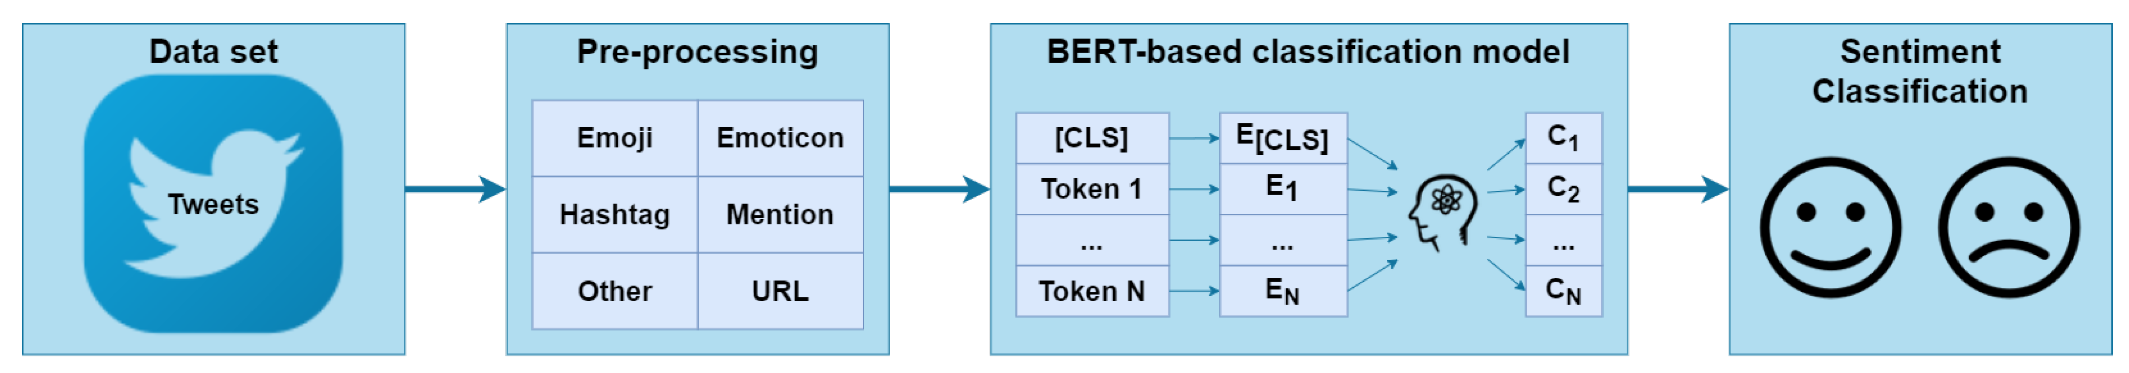
Sentiment analysis with twitter

Slide 11
But that’s not enough!
Feelings are not bidirectional
We can’t trust the Internet
Joy, Interest, Surprise, Fear, Anger, Sadness, Contempt, Disgust, Self-Hostility, Shame, Shyness, Guilt…
On the Internet, everyone is allowed to do anything with anonymous identities…

Slide 12
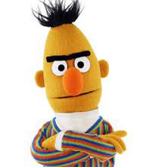
Use BERT more efficiently
If we can know how BERT works in each of its layers, we can train our model in a better way !

Slide 13
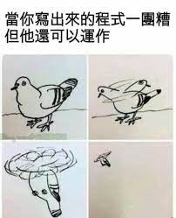

But even the NLP scientists have no idea how BERT’s layers work…
Yep, it just works
We will make a visualization tool to help data scientist know more about BERT!

Slide 14
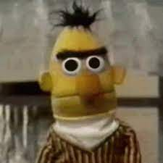
Why choosing the BERT?
BERT is very new
BERT is a good model
Pre-training ←→ Fine-tuning
We don’t understand it yet
No need to worry about it
Easy to compare & adjust

Slide 15
A BERT visualization tool
Charts
Easy-understanding charts that enable scientists to get information fast.
Comparison
Allow scientists to compare different models so they can know what’s going on.
Special tasks
Marks data with special tasks, benefits for deep data analysis.

Slide 16
實作方法
Part 3: How to do

Slide 17
Ideas about the 3 features
Easy-understanding charts
Model comparison
Special tasks
Line chart is the best way, because every word in BERT is a 768 dimensional vector, we have to draw all of them to make judgements.
Allow multiple charts with different models appear at the same time. It can also display their relations, such as deviation, average… .
This is the hardest part, because we have to know what data may the scientists want, what can help them analysis better…

Slide 18
Identify special tasks
Do some tasks first, compare between data and record the result, try to find something useful and we can mark it on the tool.
E.g. Compare positive and negative sentences to see what is the difference between them.
Compare between models, analysis the data trend in the models, and draw it on our charts.
E.g. See what’s different between “bert-base-uncased” and “bert-base-chinese”.

Slide 19
成果展示
Part 4: What I have done

Slide 20
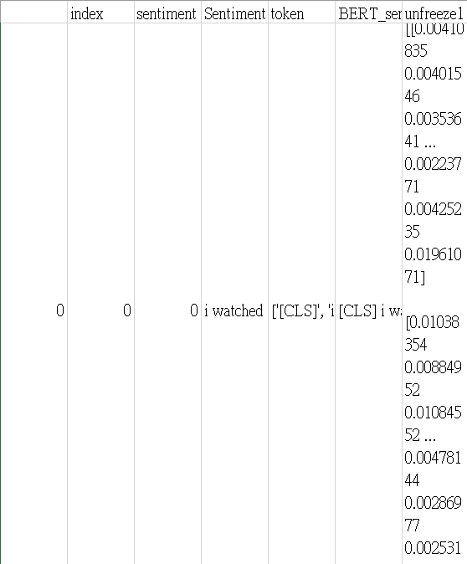
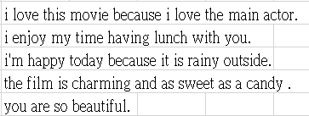
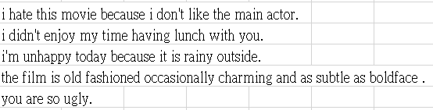
Data set that I’ve used now

Slide 21
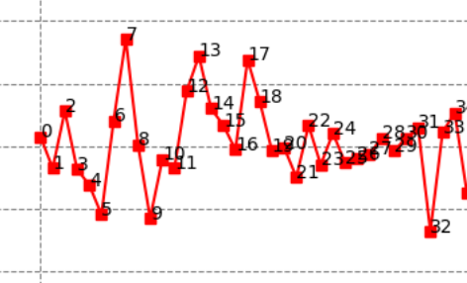
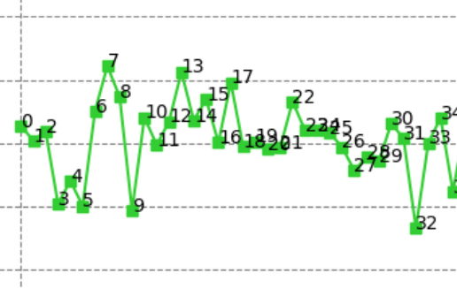
Draw line chart of the 768 vectors represent the [CLS] token of a sentence.
Compare positive and negative sentences to guess which vectors are related to defining sentiments.

Slide 22
反思&展望
Part 5: What can be better

Slide 23
Some discoveries
In negative sentences, specific dimension data value increased a lot from the positive ones.
Some continuous dimensions always changes their relations at the same time.
Some dimensions are always way too far from average (extremum happened).
Sentences that have the same meaning have same [CLS] vectors’ trend.

Slide 24
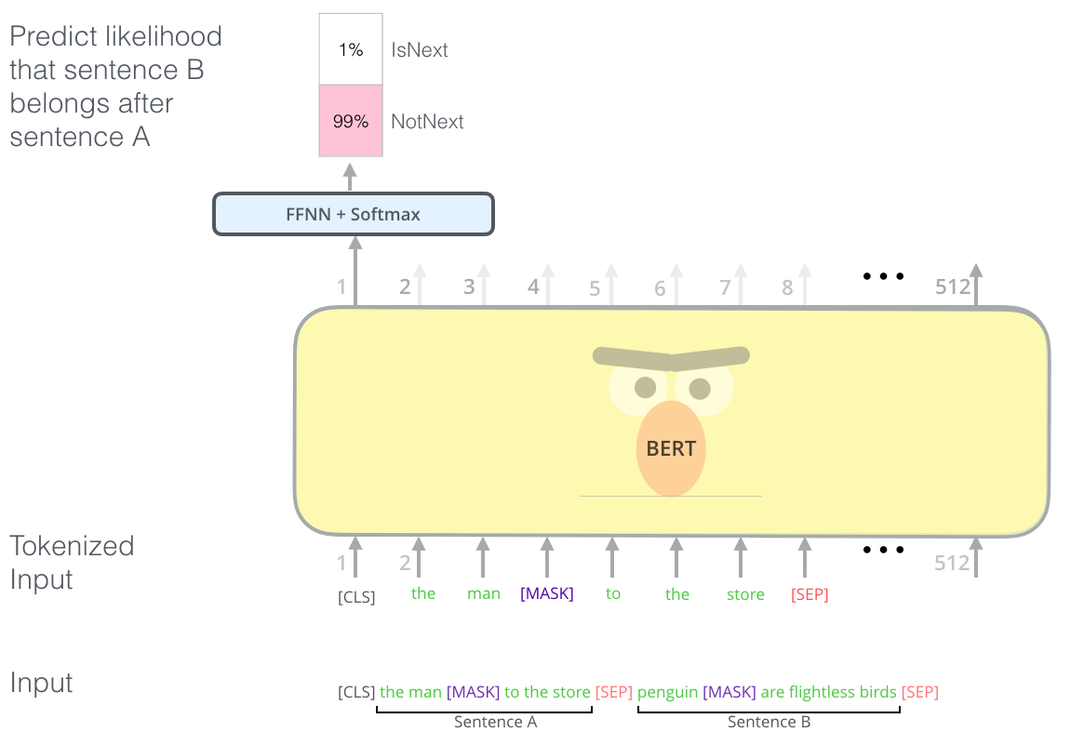
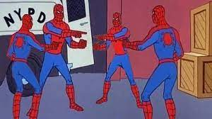
What can be done next
Compare cross layers
Increase data sets diversity
Focus on the changes through every layer, find out what work does this layer do.
Try more and more data to see if it really works, or it was all luck that they have this trend.

Slide 25
客座提問
Part 6: What you should do

Slide 26
THANK YOU!
Yes, this is also the end of the presentation
40847041S 朱自宇

